Slide 1
Getting Started with ArcGIS API for Python
Bill Major
George Bochenek
2018 Esri Developer Summit DC

Slide 2
Agenda
What is the ArcGIS API for Python?
Getting Started
Installation & Jupyter Notebooks
Help & API Reference
The GIS connection object
Accessing the “Managers”
UserManager, ContentManager, GroupManager,, etc.
Questions? – please attend additional sessions today!

Slide 3
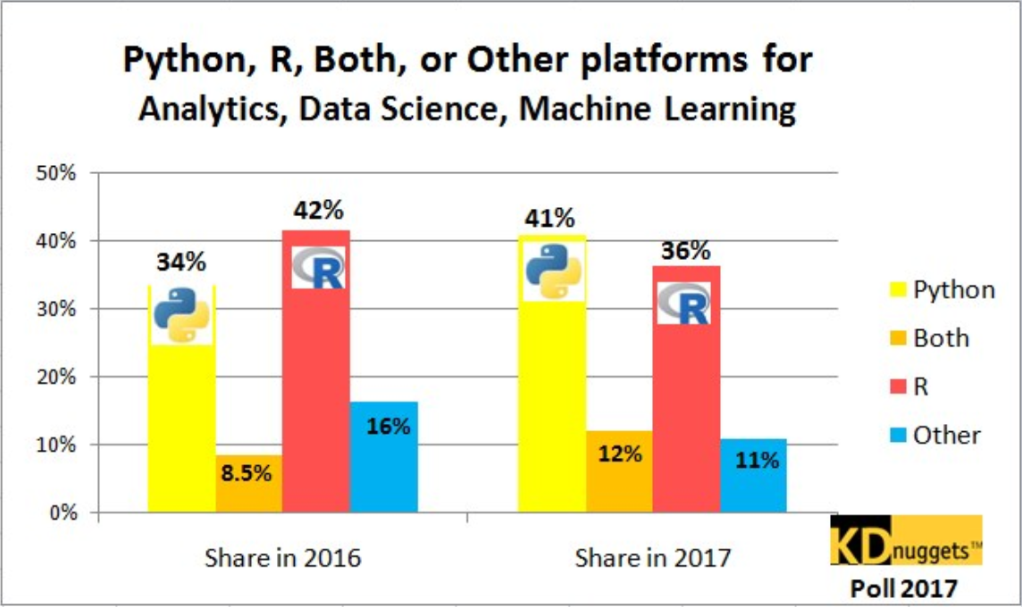








Why Python?
Popularity
Productivity
Interoperability
Solves the “two language” problem
Scientific Python ecosystem
Community

Slide 4

What is the ArcGIS API for Python?
Organization
REST

Slide 5
Overview of the ArcGIS API for Python
geo
enrichment
A Pythonic GIS API
Corresponds to best practices
Uses standard Python constructs
Data structures with clean, readable idioms
Easy for a Python programmer to use ArcGIS
Easy for an ArcGIS user to script and automate their GIS
widgets
geometry
mapping
gis
geo
processing
geocoding
geo
analytics
realtime
schematics
raster
network
features

Slide 6
ArcGIS API for Python vs ArcPy
ArcGIS API for Python
Script against your Web GIS
ArcGIS Online or ArcGIS Enterprise
Python 3.x
Analysis, Portal Admin, Content Creation, Big Data Analysis
ArcPy
ArcGIS Desktop
ArcMap – Python 2.x
ArcGIS Pro – 3.x
Mostly geoprocessing
Some map automation

Slide 7
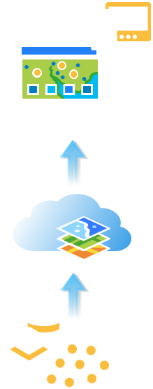
Whom is it for?
Desktop
Apps
Interactive
Exploration
GIS Analysis
Big Data GeoAnalytics
Content
Publishing
Developers
Org administration
Spatial Analysis & Geoprocessing
Notes:
Quick…get through the personas…general overview about what each group plans to do with the API
Make sure to talk the developer example from hackathons….directions or routing

Slide 8
Automate Web GIS management
Reproducible research
Populate portal with users, groups
Clone portals
Re assign user content
Perform comprehensive content search
Determine item relationship
Create reports of users, their items
Access big data tools programmatically
Utilize rich 3rd party Python packages for data analysis
Create rich charts, graphs, embed 2D and 3D maps in Jupyter Notebook environment
Share your research with data and notes with peers
Automate content creation
Automate content publishing during off peak hours
Update tiles and features from a known database
Replicate development environment content to production
Inspect and update items with broken service links
Notes:
How can all 3 personas benefit from the API?
- Admins, instead of using the UI and getting distracted from their work, can automate most of their common workflows as scripts and schedule them to run at periodic intervals
- Publishers can take care of repetitive content creation and content validation workflows through scripts and schedule them to run at known times
- scientists all over in every discipline love the Jupyter notebook environment. We have added our own enhancements in the form of widgets. Analysts can prototype algorithms, inspect datasets, and visualize their datasets. They can finally share all their work, notes, outputs as Jupyter notebooks, or publish them as html pages to their blogs.

Slide 9
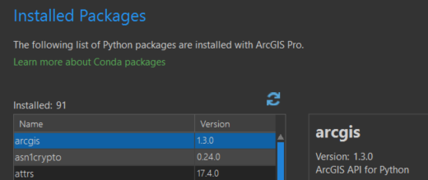

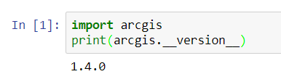
Installation
ArcGIS Pro 2.1?
arcgis package comes deployed and ready to use.
Install Anaconda with Python 3.5 or later
conda install –c esri arcgis
Conda will install all dependencies
Test it out

Slide 10
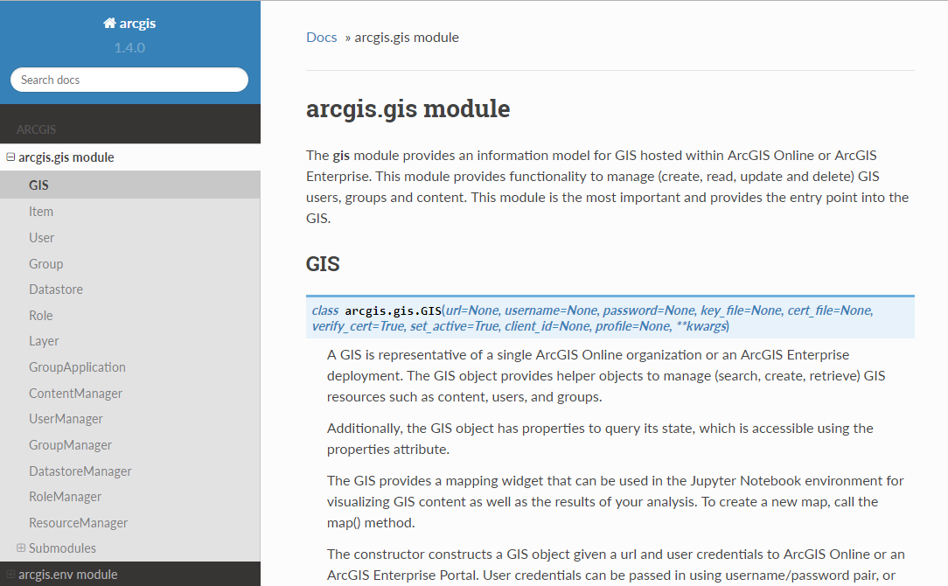
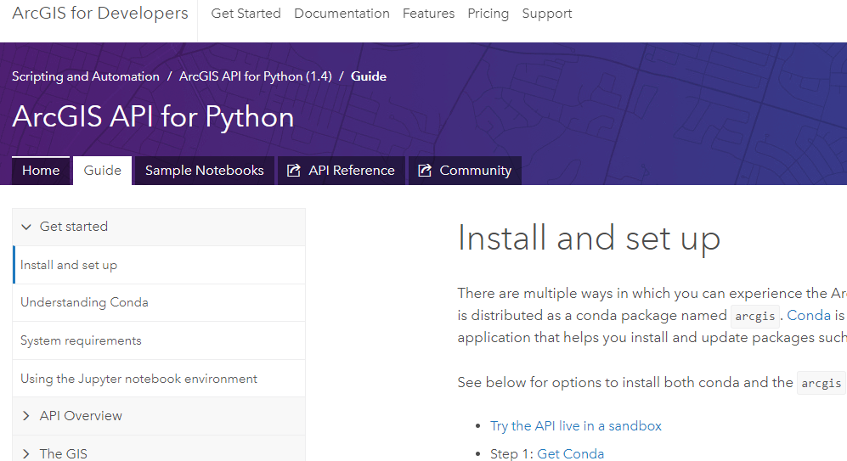
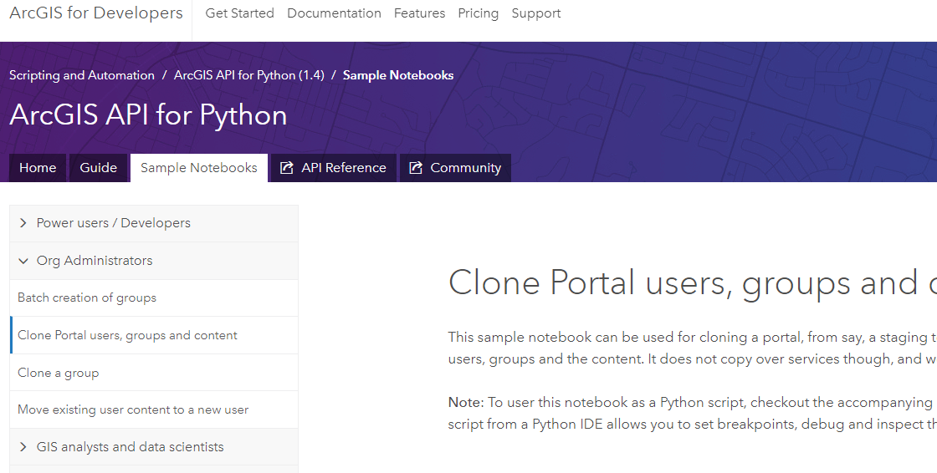
Help Documentation, API, and Samples
https://developers.arcgis.com/python/

Slide 11
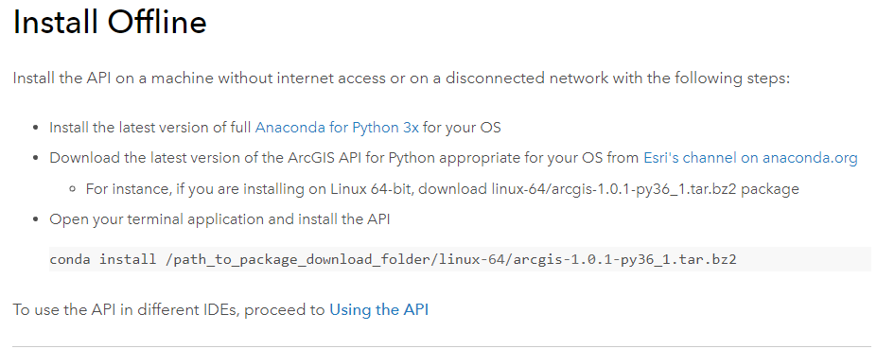
Disconnected Considerations
Can you use the Python API in disconnected environments?
Yes!!
ArcGIS Pro 2.1+
Download Anaconda, move to disconnected network, and install
Download arcgis package from Conda, move to disconnected nework, and install
Will need a local JSAPI for Map Widget Notebook integration
Modify custom.css and mapview.js

Slide 13
Different Authentication Schemes
Anonymous users
Built-in users
Users using LDAP, via
Basic authentication
Portal tier authentication
SAML Support
Users using Integrated Windows Authentication (IWA) through NTLM or Kerberos
Smart card users / PKI authentication using certificate and key files
Users connected to an ArcGIS Enterprise instance using ArcGIS Pro

Slide 14

Demos

Slide 15


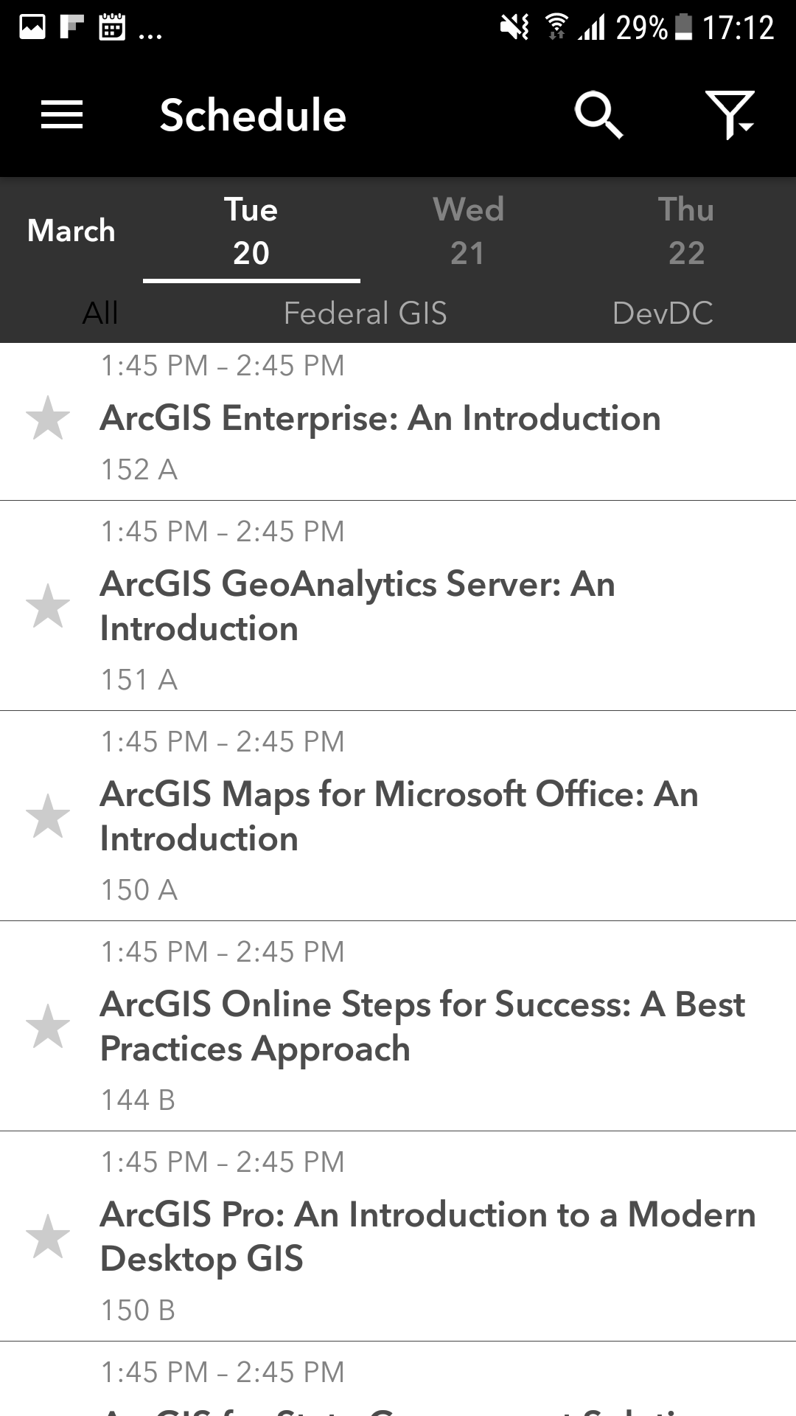
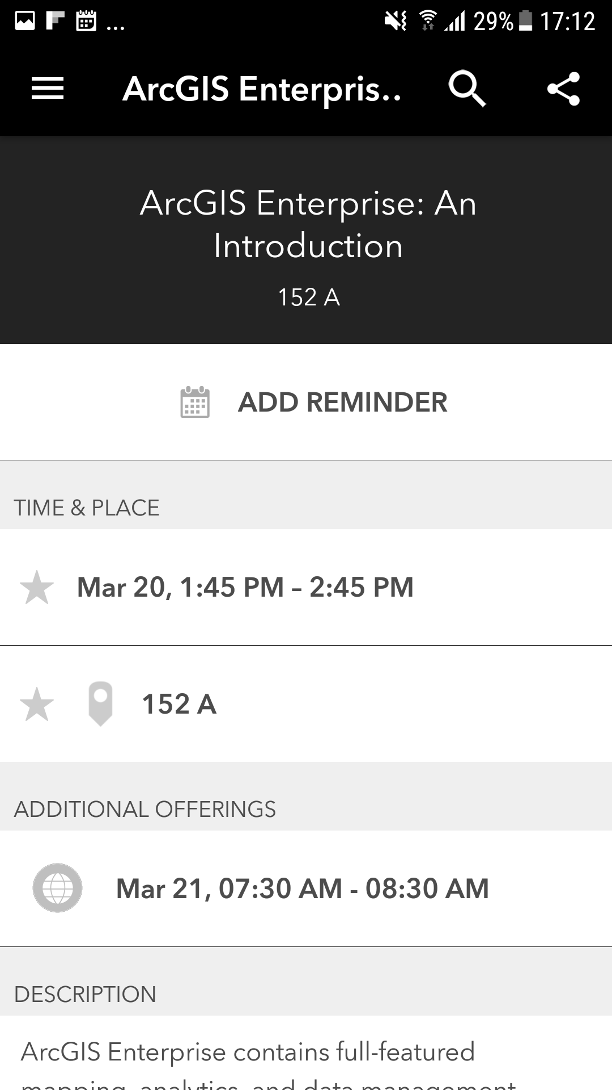
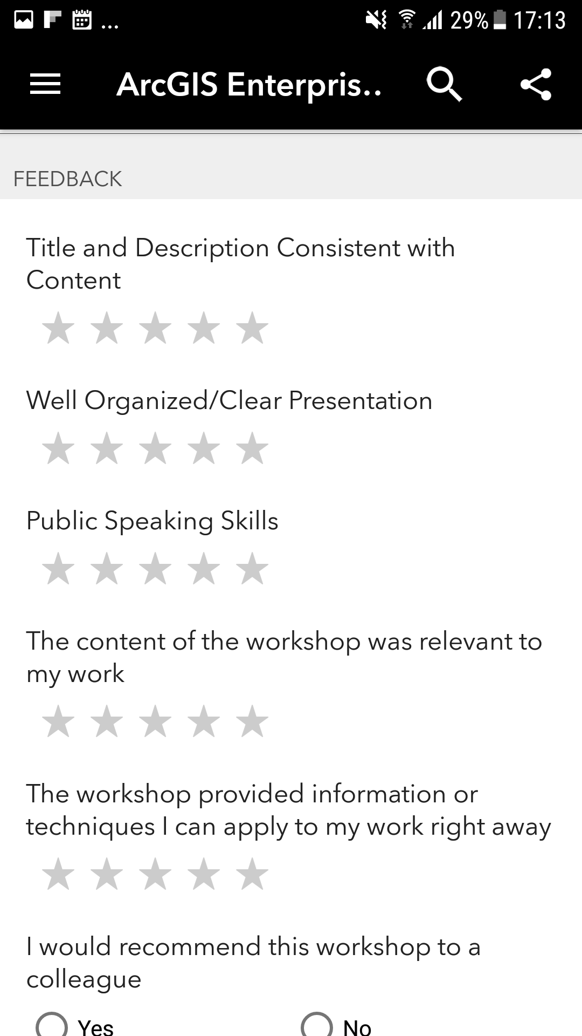
Please Take Our Survey in the Esri Events App
Download the Esri Events app and find your event
Select the session you attended
Scroll down to find the feedback section
Complete answers
and select “Submit”

Slide 16



